Slide 1
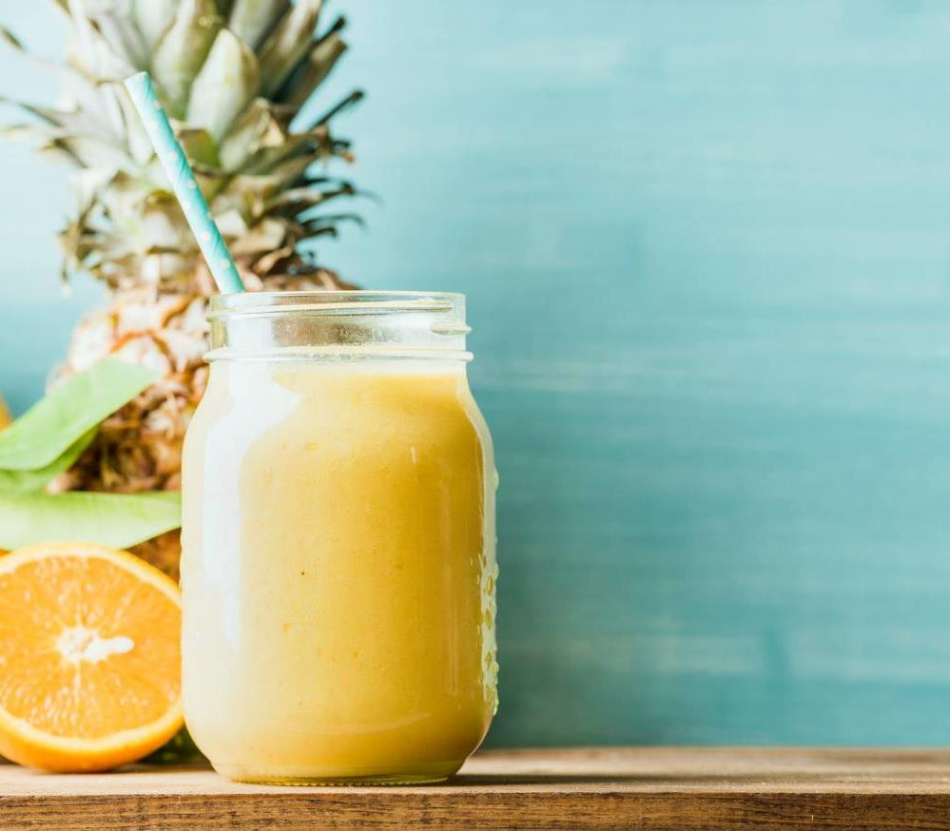
Tasty Trend A Healthy way
Assignment no : 02
Pratik Jadhav

Slide 2



Agenda
Design a business development strategy for a Fast-food shop took on rent near BTM layout, Bangalore.
The shop has got a profit graph for first three months and dealing with loss for next consecutive four months.
Provide a fruitful solution for the vendor for his business.

Slide 3


Approach :
Basic Data
Food Items Offered
Sample Data (First 3 Months)
Profit Analysis
Sample Data (Next 4 Months)
Loss Analysis
Solution
Business Growth

Slide 4
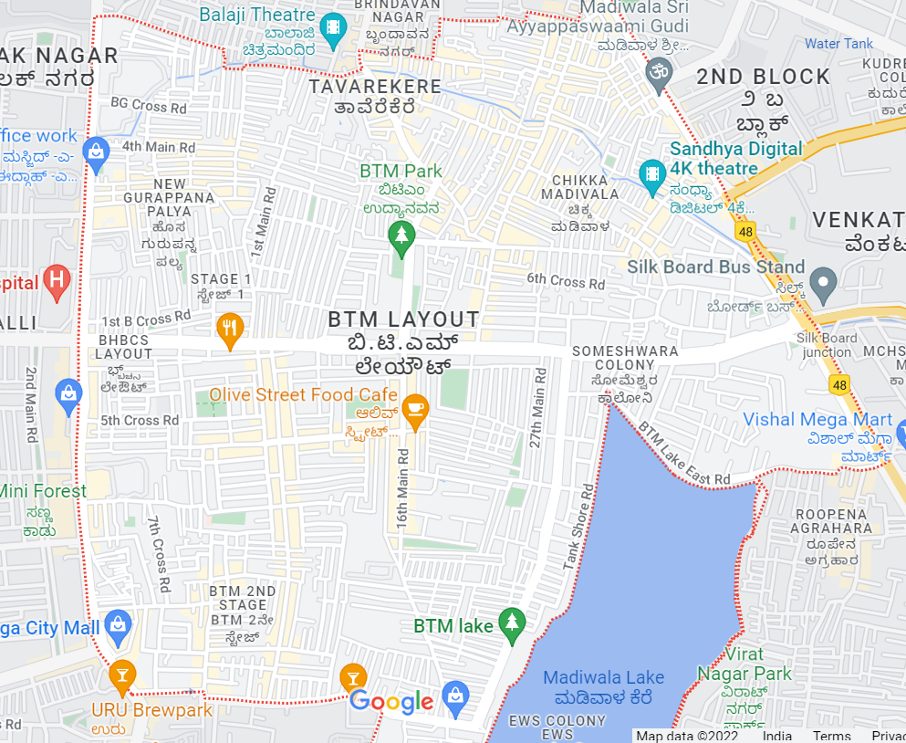
Basic Data
Location : Near BTM Layout, Bangalore.
Shop Timing : Morning 8 AM - Evening 8 PM
Working Days : Tue- Sun.
Investment Made : INR 4,00,000
Rent (Monthly) : Rs. 14,000
First 3 Months :
Sales Achieved : INR 3,00,000
Profit : INR 1,00,000

Slide 5
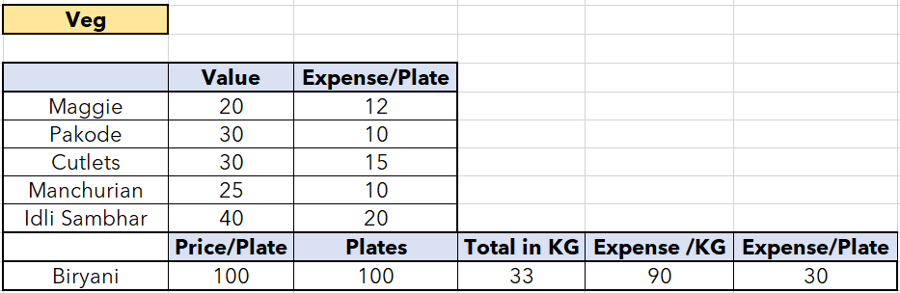
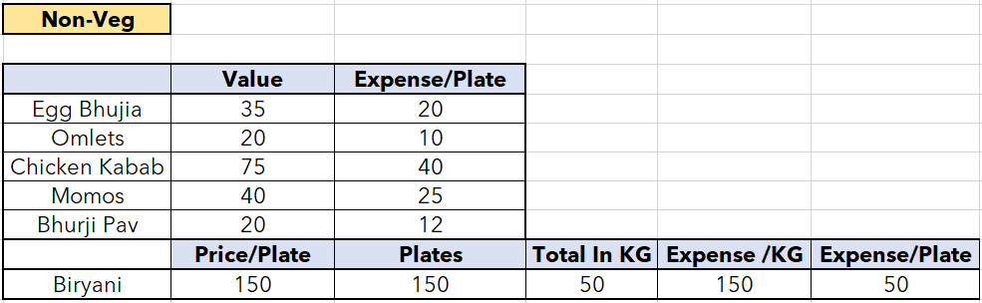
Menu :
For the 1st Month owner was selling Veg Foods as well.
From the 2nd Month he has stopped the veg foods as stock was not getting out.

Slide 6
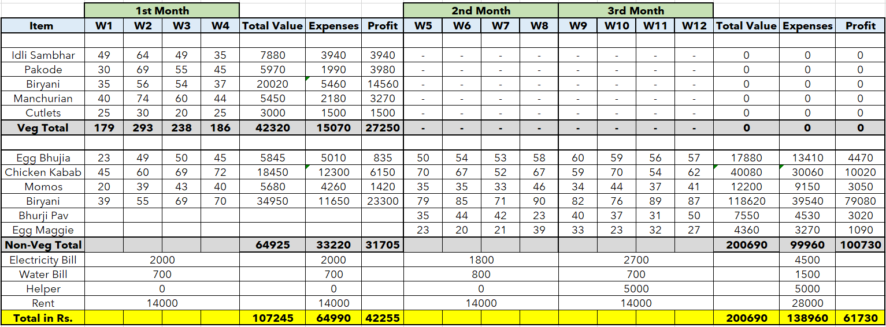
Sample Data (First 3 months)
Total Sale = Rs. 3,07,935
Total Profit = Rs. 1,03,985

Slide 7
Profit Analysis
Offered Reasonable Rates.
No competitors.
Only one helper from 3rd month.
Taken orders over phone for local.

Slide 8
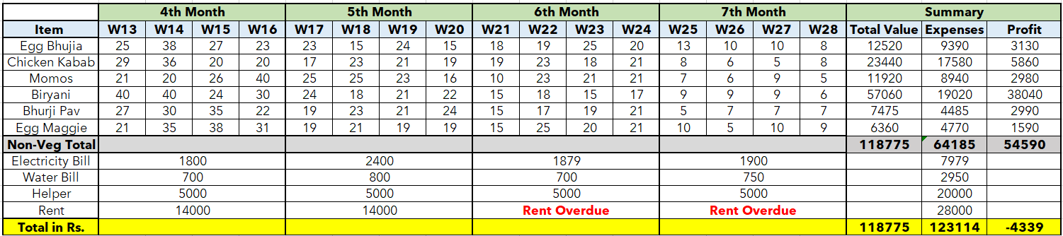

Sample Data (Next 4 months)
Order quantity can be seen decreasing throughout the weeks

Slide 9
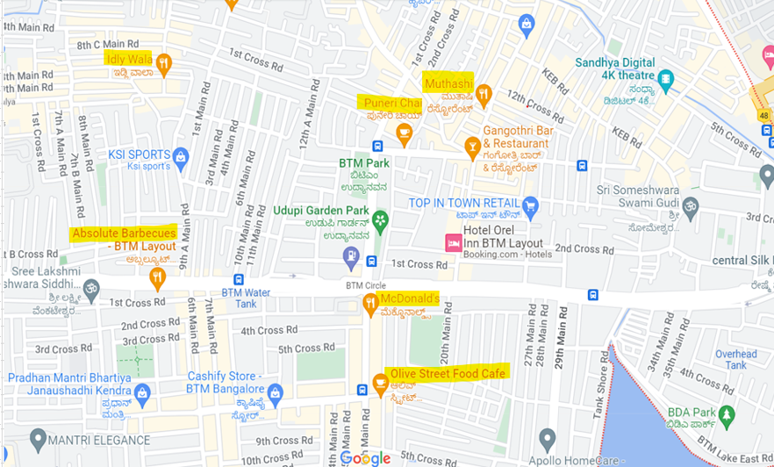
Loss Analysis
Possible reasons for Loss :
Stoppage of Veg food Selling
Not Expansion on Business with Marketing
and advertising.
Non accepting orders through Food delivery apps. (ex. Zomato)
Various shops opening nearby
Laziness Of Owner

Slide 10




Way Outs
Try to start making prime Veg foods available. (ex. Biryani)
Expand the business with accepting on call food deliveries
Accepting online deliveries from Food Apps like Zomato, swiggy
Try to amaze customers with price discounts and variety of food
Try to serve the foods along the locally popular drinks. (Ex. Chai, Lassi etc.)
Expand the business with various social Marketing strategies.
Ensure proper lighting, Cleanliness and Interior within shop
Being more Enthusiastic and energetic during work hours

Slide 11
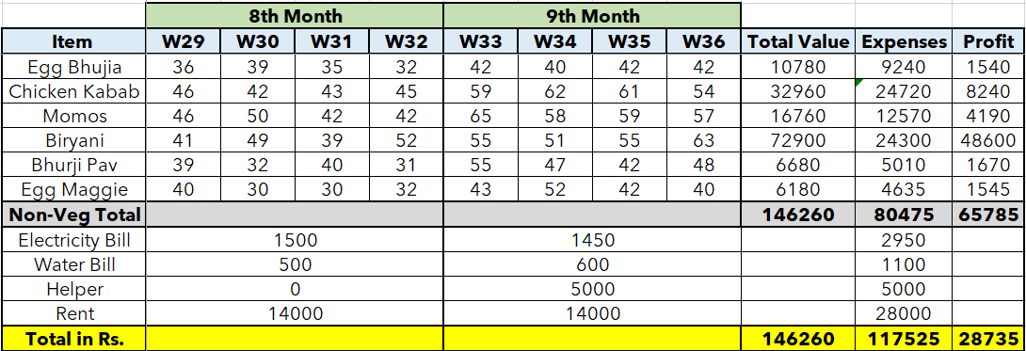
Outcome

Slide 12


Summary
After proper implementing the suggested solution we can see a well increased sale and overcome of the loss.

Slide 13



Thank you

